Slide 1

Harshal PATIL
British Airways Customer Reviews Analysis
This project was completed as part of a Virtual Work Experience Program with British Airways, hosted on the Forage platform.

Slide 2
Introduction
British Airways, one of the world’s leading airlines, is renowned for its global connectivity and premium services. To stay competitive and customer-centric, it is crucial to understand user behavior and feedback. This project focuses on collecting customer reviews from Skytrax and building a predictive model to identify whether a customer will complete a booking or not, using British Airways’ internal booking dataset.

Slide 3
OBJECTIVES
Scrape and analyze customer sentiment from review data on Skytrax.
Predict the likelihood of booking completion using machine learning.
Identify the most influential factors affecting bookings.
Provide actionable insights for improving customer experience and conversions.

Slide 4
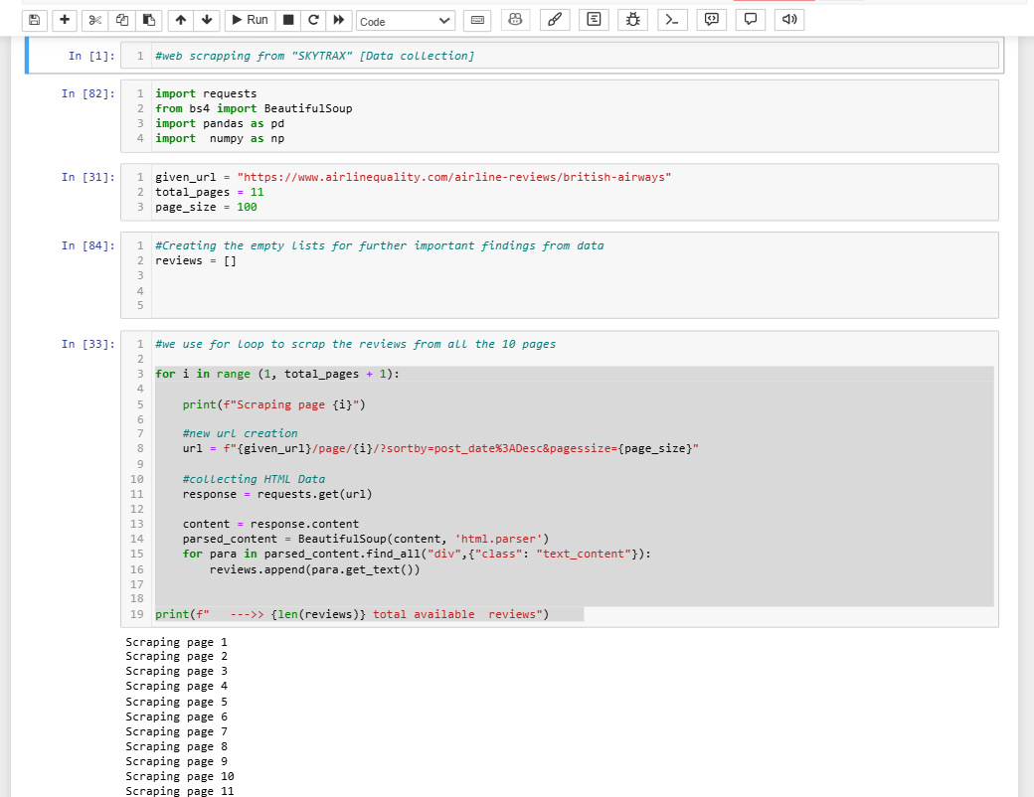
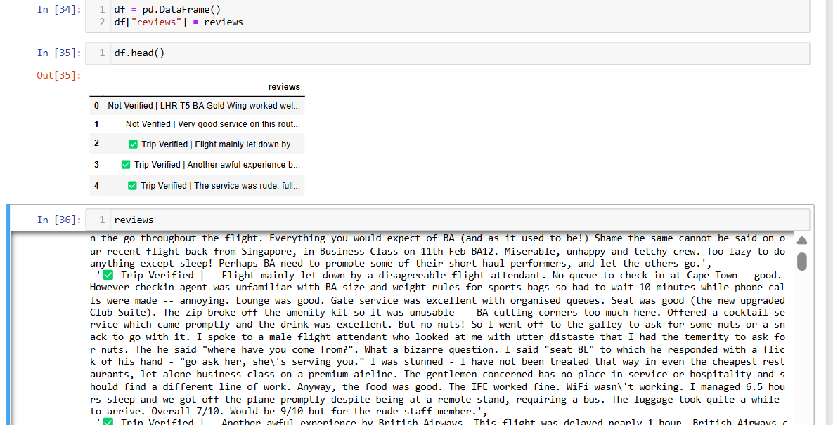
Data scraping through python

Slide 5
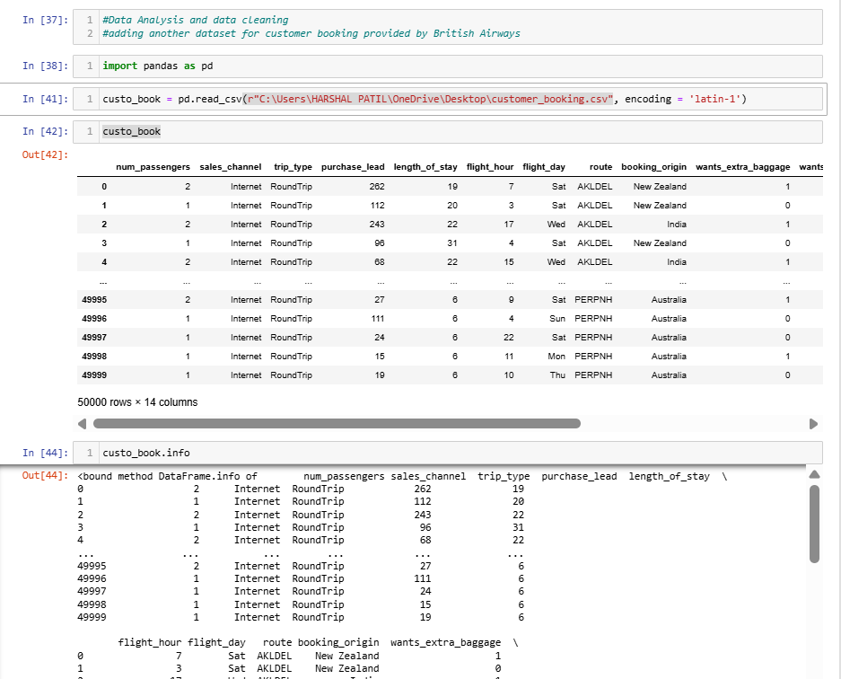
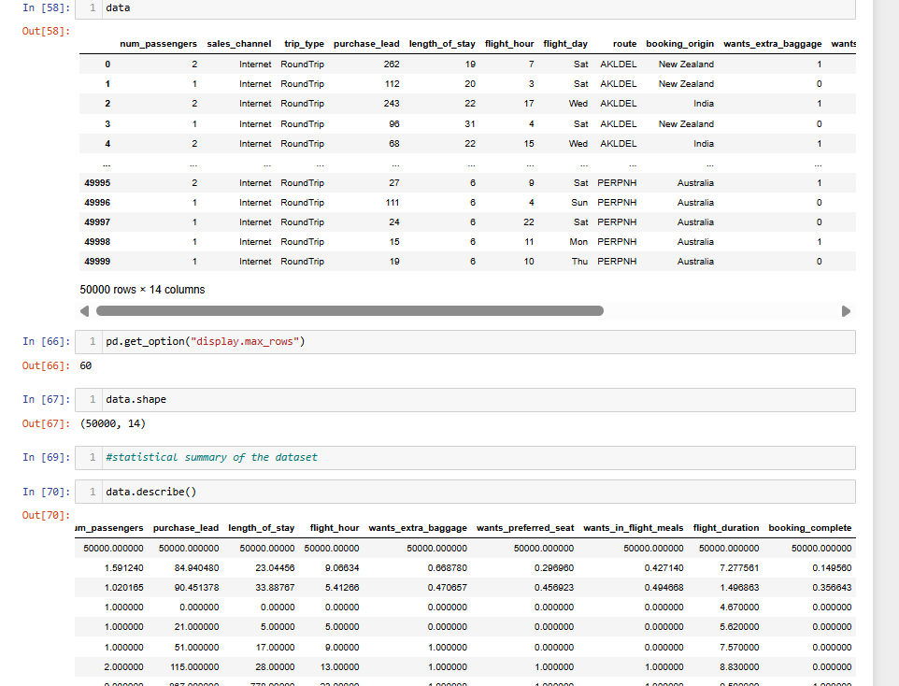
Data cleaning & Analysis

Slide 6
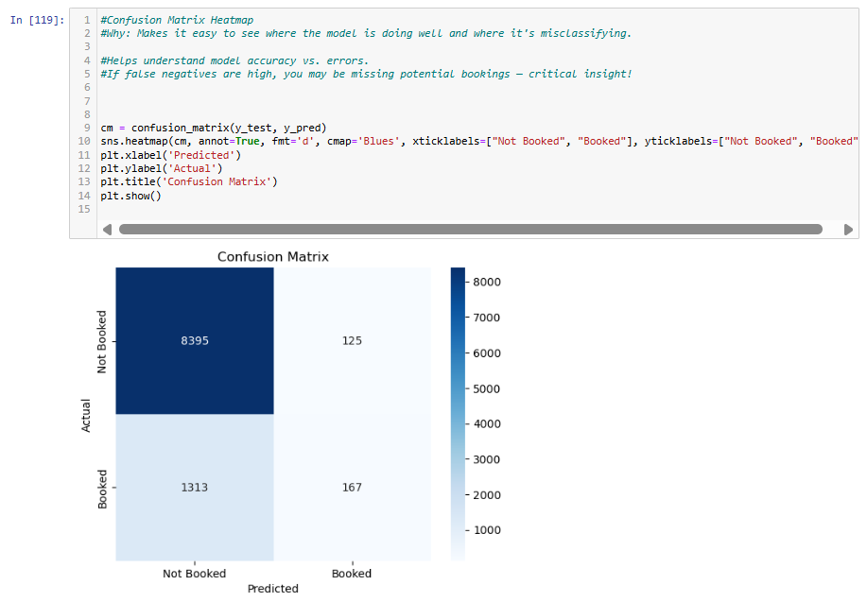
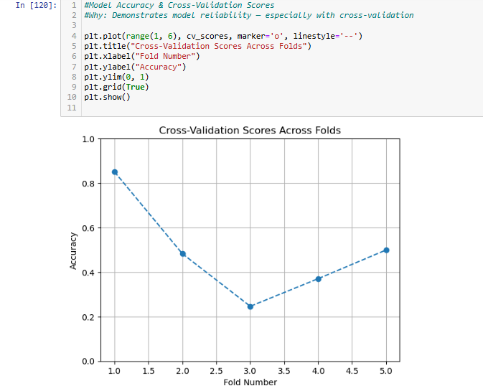
Findings

Slide 7
AREAS TO WORK (Based on Customer Reviews)
Service Quality: Multiple reviews highlight inconsistent service across flights.
Onboard Experience: Passengers frequently mention seating comfort and in- flight entertainment.
Timeliness: Complaints about delays and schedule adherence are common.
Ground Staff Attitude: Mixed experiences indicate the need for consistent training.

Slide 8
AREAS OF IMPROVEMENT
Enhance Premium Cabin Experience: Top customers expect more from business and first class.
Booking System Optimization: Many drop-offs could be avoided by streamlining digital booking flows.
Pricing Strategies: Dynamic pricing or special offers could help convert hesitant bookers.
Customer Support Responsiveness: Faster issue resolution can improve verified booking rates.

Slide 9
CONCLUSION
This analysis provides a data-driven foundation for strategic decisions in marketing, service quality, and UX improvements. By combining customer sentiment with predictive analytics, British Airways can personalize experiences, improve satisfaction, and ultimately increase booking conversion rates.

